Slide 1

Chandigarh School of Business, Jhanjeri
Department of Computer Application
Program Code: NA
Program Name: MCA
Course Code: PGCA1937
Course Name: Cloud Computing
Prepared by: Dr. Gurvir Kaur

Slide 2

Outlines
PTU Syllabus of Unit-I
CO’s Introduction
Topic Overview
Brief description of what the presentation will cover
Importance or relevance of the topic
Key objectives or learning outcomes
Summary
References

Slide 3
PTU Syllabus of Unit-I
Part-A
Overview of Computing Paradigm: Recent trends in Computing -Grid Computing, Cluster Computing, Distributed Computing, Utility Computing, Cloud Computing.
Introduction to Cloud Computing: Vision of Cloud Computing, Defining a Cloud, Cloud Reference Model, Deployment Model, Characteristics, Benefits of Cloud Computing, Challenges ahead. Cloud computing vs. Cluster computing vs. Grid computing.
Migrating into a Cloud: Introduction, Broad approaches to Migrating into the Cloud, The Seven-Step Model of Migration Into a Cloud.
Virtualization: Introduction, Characteristics of Virtualized environment, Taxonomy of Virtualization techniques, Virtualization and Cloud Computing, Pros and Cons of Virtualization, Technology Examples- Xen, VMware, Microsoft Hyper-V.
Capacity Planning: Introduction, Defining Baseline and Metrics-Baseline Measurements, System Metrics, Load Testing, Resource Ceilings, Server and Instance types; Network Capacity, Scaling.

Slide 4
Key objectives or learning outcomes
CO1 Understand the basic concept and importance of cloud computing.
CO2 Access the suitability of migrating to a cloud solution for different applications.
CO3 Compare and evaluate the virtualization technologies.
CO4 Monitor and manage the cloud resources, applications and data while addressing the security concerns.
CO5 Use cloud solutions offered by industry leaders for various applications.

Slide 5
CO Introduction
CO NUMBER | TOPICS | LEVEL
CO1 | Overview of Computing Paradigm: Recent trends in Computing -Grid Computing, Cluster Computing, Distributed Computing, Utility Computing, Cloud Computing. Introduction to Cloud Computing: Vision of Cloud Computing, Defining a Cloud, Cloud Reference Model, Deployment Model, Characteristics, Benefits of Cloud Computing, Challenges ahead. Cloud computing vs. Cluster computing vs. Grid computing. | 2

Slide 6
Topic Overview
Cloud services are typically offered through three main models: IaaS (Infrastructure as a Service), PaaS (Platform as a Service), and SaaS (Software as a Service), with deployment options including public, private, and hybrid clouds.
This technology has become essential in enabling businesses and individuals to efficiently store, process, and access data and applications anytime, anywhere, promoting innovation, collaboration, and cost efficiency.
These paradigms enable parallel processing and resource sharing, improving performance, scalability, and fault tolerance.

Slide 7
Brief of what the presentation will
The presentation will cover the following points:
Introduction to Cloud Computing
Vision of Cloud Computing
Defining a Cloud
Characteristics
Benefits of Cloud Computing
Cloud Reference Model
Deployment Model
Challenges ahead

Slide 8
Importance of the topic
Scalability and Flexibility: Cloud computing provides on-demand access to a vast range of resources, enabling businesses to scale up or down based on their needs.
Cost Efficiency: By using cloud services, businesses can significantly reduce costs associated with maintaining and upgrading physical hardware.
Accessibility and Collaboration: Cloud computing allows users to access data and applications from any device with an internet connection, facilitating remote work and global collaboration. This enhances productivity, supports flexible work environments, and enables real-time collaboration across teams and locations.

Slide 9
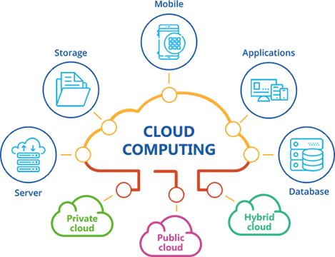
Detail Topics
Computing is being transformed into a model consisting of services that are commoditized and delivered in a manner similar to utilities such as water, electricity, gas, and telephony.
In such a model, users access services based on their requirements, regardless of where the services are hosted.
Cloud computing is the most recent emerging paradigm promising to turn the vision of “computing utilities” into a reality.

Slide 10
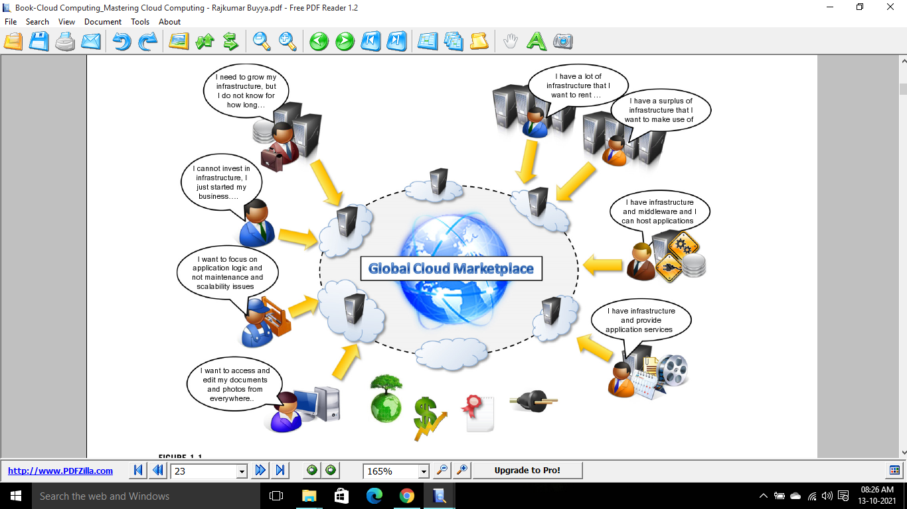
The vision of cloud computing

Slide 11
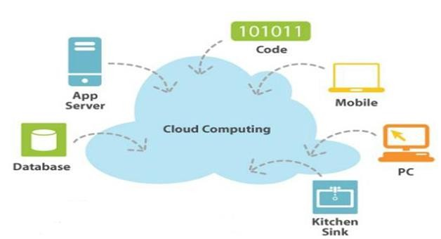
Cloud Computing
US National Institute of Standards and Technology (NIST) defines Computing as:
“ Cloud computing is a model for enabling ubiquitous, convenient, on-demand network access to a shared pool of configurable computing resources (e.g. networks, servers, storage, applications, and services) that can be rapidly provisioned and released with minimal management effort or service provider interaction. ”
http://www.smallbiztechnology.com/archive/2011/09/wait-what-is-cloud-computing.html

Slide 12
Essential Characteristics
On-demand self-service
  A consumer can unilaterally provision computing capabilities, such as server time and network storage, as needed automatically without requiring human interaction with each service provider.
Broad network access
  Capabilities are available over the network and accessed through standard mechanisms that promote use by heterogeneous thin or thick client platforms (e.g., mobile phones, tablets, laptops, and workstations).
Resource pooling
  The provider’s computing resources are pooled to serve multiple consumers using a multi-tenant model, with different physical and virtual resources dynamically assigned and reassigned according to consumer demand.

Slide 13
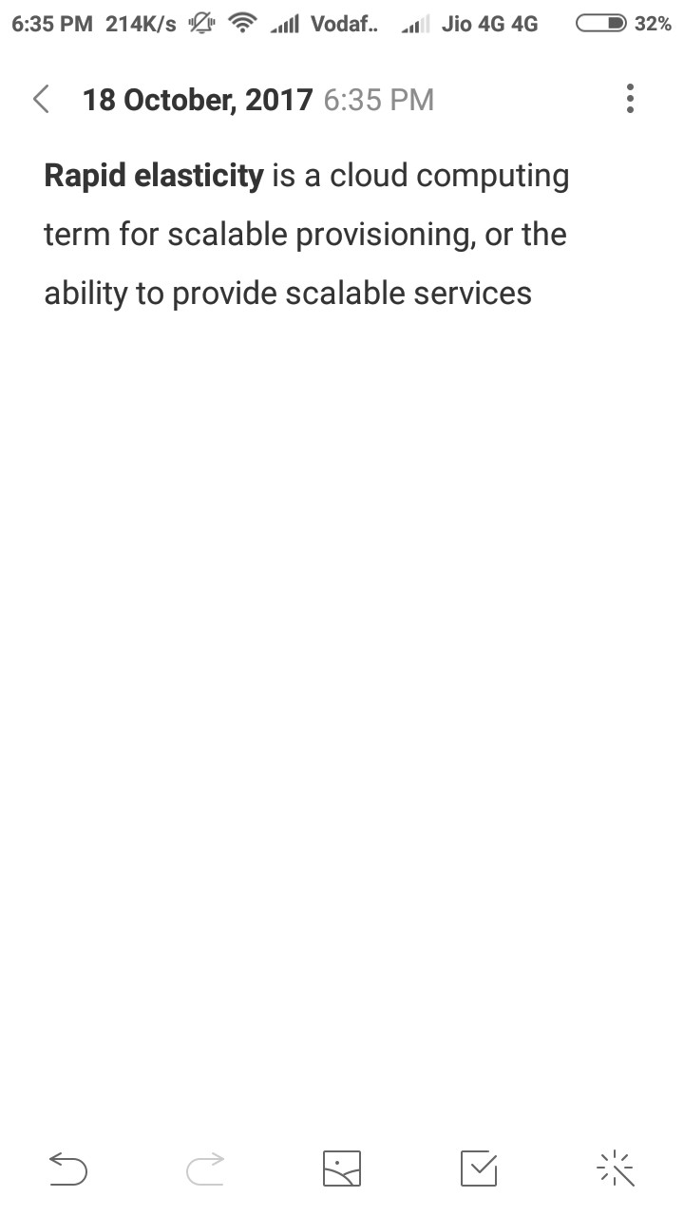
Cloud Characteristics
Measured Service
  Cloud systems automatically control and optimize resource use by leveraging a metering capability at some level of abstraction appropriate to the type of service (e.g., storage, processing, bandwidth, and active user accounts). Resource usage can be
  monitored, controlled, and reported, providing transparency for both the provider and consumer of the utilized service.
Rapid elasticity
  Capabilities can be elastically provisioned and released, in some cases automatically, to scale rapidly outward and inward commensurate with demand. To the consumer, the capabilities available for provisioning often appear to be unlimited and can be appropriated in any quantity at any time.

Slide 14
Common Characteristics
Massive Scale
Resilient Computing
Homogeneity
Geographic Distribution
Virtualization
Service Orientation
Low Cost Software
Advanced Security

Slide 15
Cloud Services Models
Software as a Service (SaaS)
The capability provided to the consumer is to use the provider’s applications running on a cloud infrastructure. The applications are accessible from various client devices through either a thin client interface, such as a web browser (e.g., web-based email), or a program interface.
■
■
The consumer does not manage or control the underlying cloud infrastructure including network, servers, operating systems, storage, or even individual application capabilities, with the possible exception of limited user-specific application configuration settings.
e.g: Google Spread Sheet
■
Cloud Infrastructure as a Service (IaaS)
The capability provided to provision processing, storage, networks, and other fundamental computing resources
Consumer can deploy and run arbitrary software
e.g: Amazon Web Services and Flexi scale.
■
■
■

Slide 16
Cloud Services Models
Platform as a Service (PaaS)
The capability provided to the consumer is to deploy onto the cloud infrastructure consumer-created or acquired applications created using programming languages, libraries, services, and tools supported by the provider.
■
The consumer does not manage or control the underlying cloud infrastructure including network, servers, operating systems, or storage, but has control over the deployed applications and possibly configuration settings for the application-hosting environment.
■

Slide 17
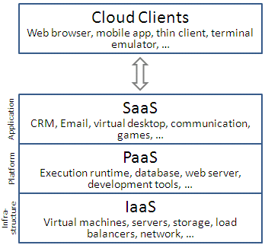
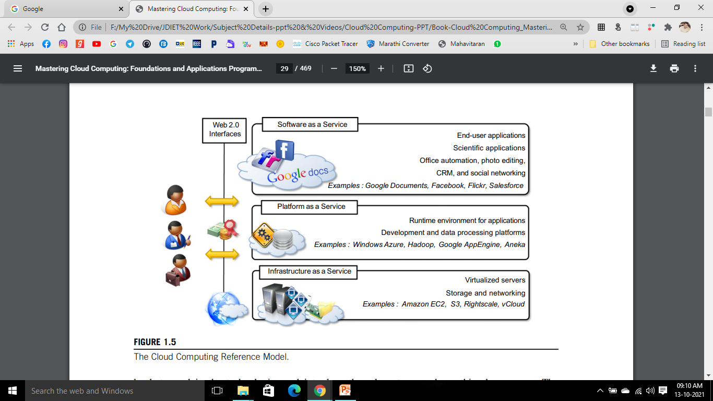
Cloud Services Models

Slide 18
Types of Cloud (Deployment Models)
Private cloud
The cloud infrastructure is operated solely for an organization.
e.g Window Server 'Hyper-V'.
Community cloud
The cloud infrastructure is shared by several organizations and supports a specific goal.
Public cloud
The cloud infrastructure is made available to the general public
e.g Google Doc, Spreadsheet,
Hybrid cloud
The cloud infrastructure is a composition of two or more clouds (private, community, or public)
e.g Cloud Bursting for load balancing between clouds.

Slide 19
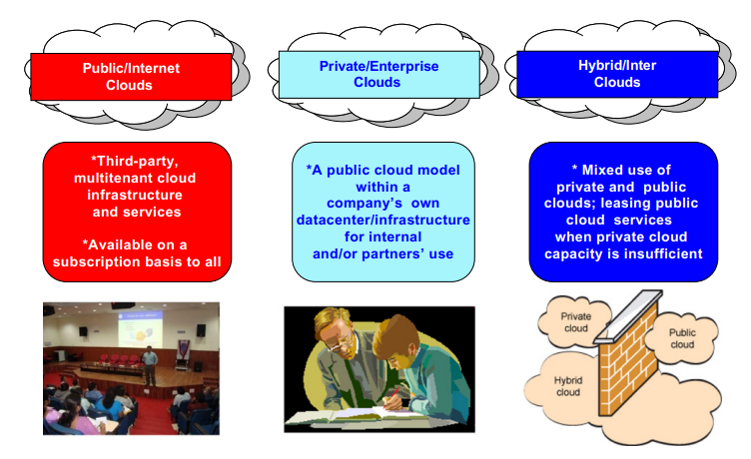
Types of Cloud (Deployment Models)

Slide 20
Challenges ahead
As any new technology develops and becomes popular, new issues have to be faced.
New, interesting problems and challenges are regularly being posed to the cloud community, including IT practitioners, managers, governments, and regulators.
which are related to configuration, networking, and sizing of cloud computing systems, a new set of challenges concerning the dynamic provisioning of cloud computing services and resources arises.
Technical challenges also arise for cloud service providers for the management of large computing infrastructures and the use of virtualization technologies .

Slide 21
Challenges ahead
Security in terms of confidentiality, secrecy, and protection of data in a cloud environment is another important challenge.
The confidentiality of data and compliance to security standards, which give a minimum guarantee on the treatment of information on cloud computing systems (Cryptographic).
Different legislation about privacy in different countries may potentially create disputes as to the rights that third parties (including government agencies) have to your data.

Slide 22
Summary
On-Demand Access to Resources: Cloud computing allows users to access computing resources like storage, computing power, and software over the internet, eliminating the need for physical hardware and infrastructure.
Scalability & Cost Efficiency: Cloud computing provides the ability to scale resources up or down as needed, with a pay-as-you-go pricing model, reducing costs and optimizing resource usage.
Flexible Service Models
Deployment Flexibility

Slide 23
References
Books References
Mastering Cloud Computing, Rajkumar Buyya, Christian Vecchiola, and ThamaraiSelvi, Tata McGraw Hill, ISBN-13: 978-1-25-902995-0, New Delhi, India,Feb 2013.
E-book link
https://archive.org/details/cloudcomputingbi0000sosi
YouTube link
https://www.youtube.com/@cloudcomputing351/videos
https://www.geeksforgeeks.org/cloud-computing/
https://www.tutorialspoint.com/cloud_computing/index.htm
https://nptel.ac.in/courses/106105167
https://www.edx.org/learn/cloud-computing

Slide 24
THANK YOU

